Slide 1
Global Health Diplomacy: Fostering Collaborations for Pandemic Preparedness and Response
Dr. Jasna Karacic-Zanetti
Health Diplomacy Unit, Bruxelles
University of Zagreb, Croatia

Slide 2
Introduction
The emergence and global spread of COVID-19 have underscored the critical role of international cooperation in addressing infectious disease threats.
This presentation explores the concept of Global Health Diplomacy (GHD) as a framework for fostering collaboration in pandemic preparedness and response.

Slide 3
What is Global Health Diplomacy (GHD)?
Global Health Diplomacy refers to the use of diplomatic channels to address global health challenges.
It involves promoting dialogue and joint efforts between nations to strengthen health systems, facilitate knowledge sharing, and ensure equitable access to resources during pandemics.

Slide 4
Key Areas of Focus in GHD
GHD can foster collaboration in several critical areas:
Strengthening Surveillance and Early Warning Systems
Facilitating Research and Development
Ensuring Equitable Access to Resources

Slide 5
Strengthening Surveillance and Early Warning Systems
Effective disease surveillance is crucial for early detection and rapid response to outbreaks.

Slide 6
Data sharing across borders
Real-time communication between health agencies
Joint research efforts to improve global disease monitoring
GHD can enhance collaboration on:

Slide 7
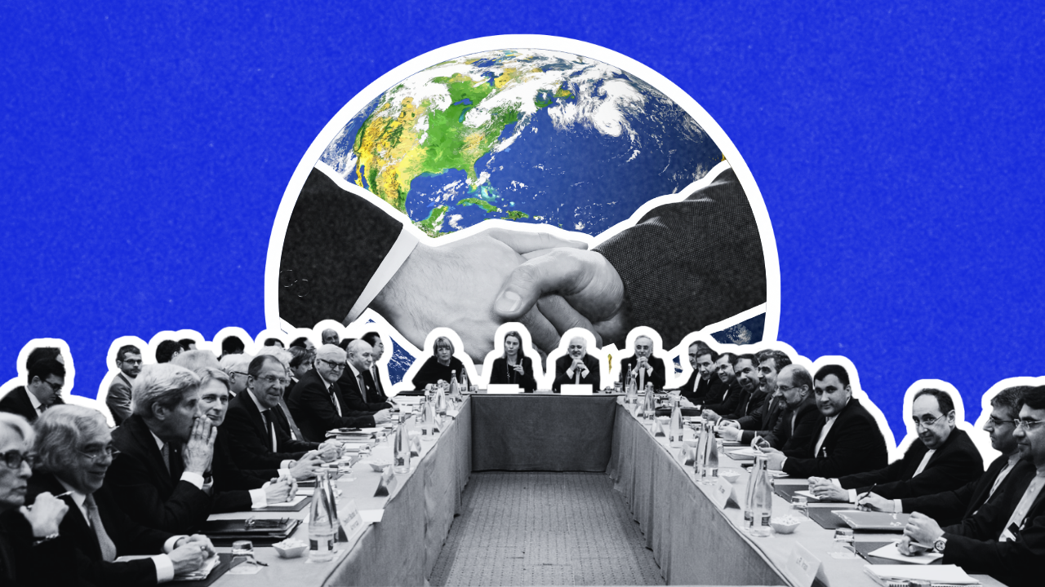
Facilitating Research and Development
Collaboration is essential for accelerating research and development (R&D) during pandemics.

Slide 8
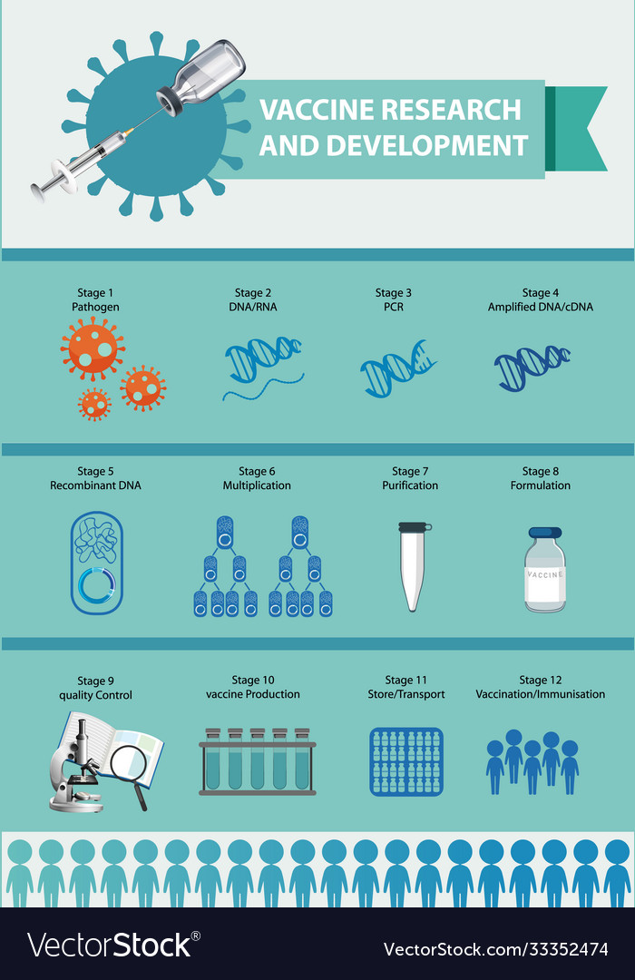
GHD can promote partnerships between:
Governments
Academic and research institutions
Pharmaceutical companies

Slide 9
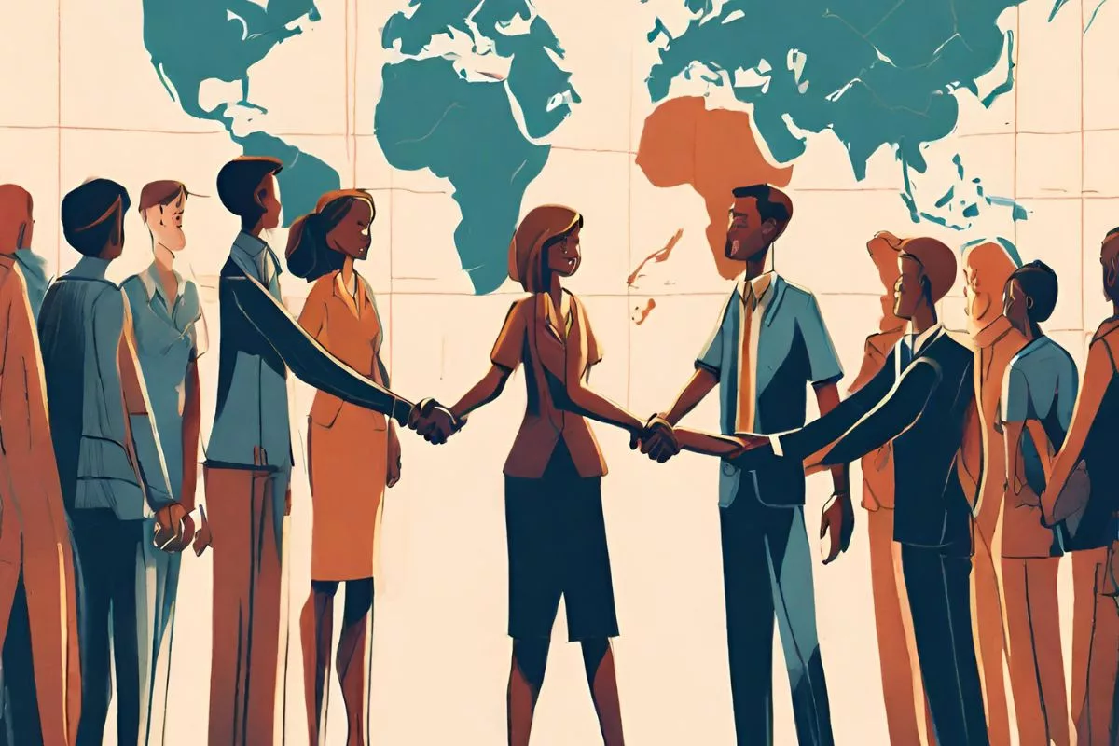
These partnerships are vital for the swift development of vaccines, diagnostics, and therapeutics.

Slide 10
Ensuring Equitable Access to Resources
Pandemics disproportionately impact vulnerable populations.
GHD promotes international cooperation to ensure equitable access to:
Essential medical supplies
Diagnostics
Vaccines

Slide 11
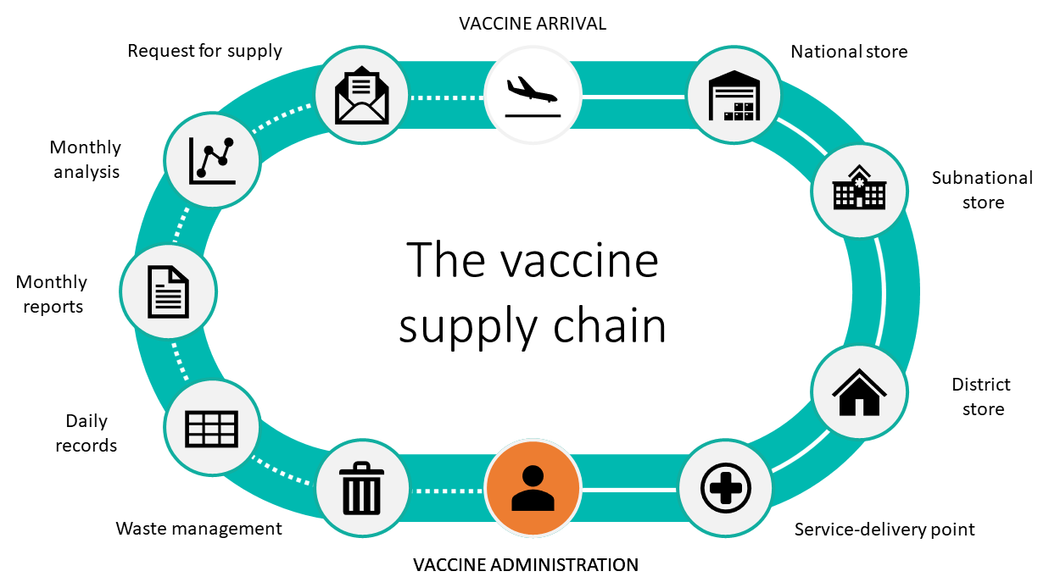
This Equitable Distribution is Key to a Fair and Effective Global Response

Slide 12
Case Study: COVID-19 Response
The COVID-19 pandemic highlighted the importance of GHD.
Initiatives like COVAX exemplify how international collaboration can work to provide vaccines to low- and middle-income countries

Slide 13
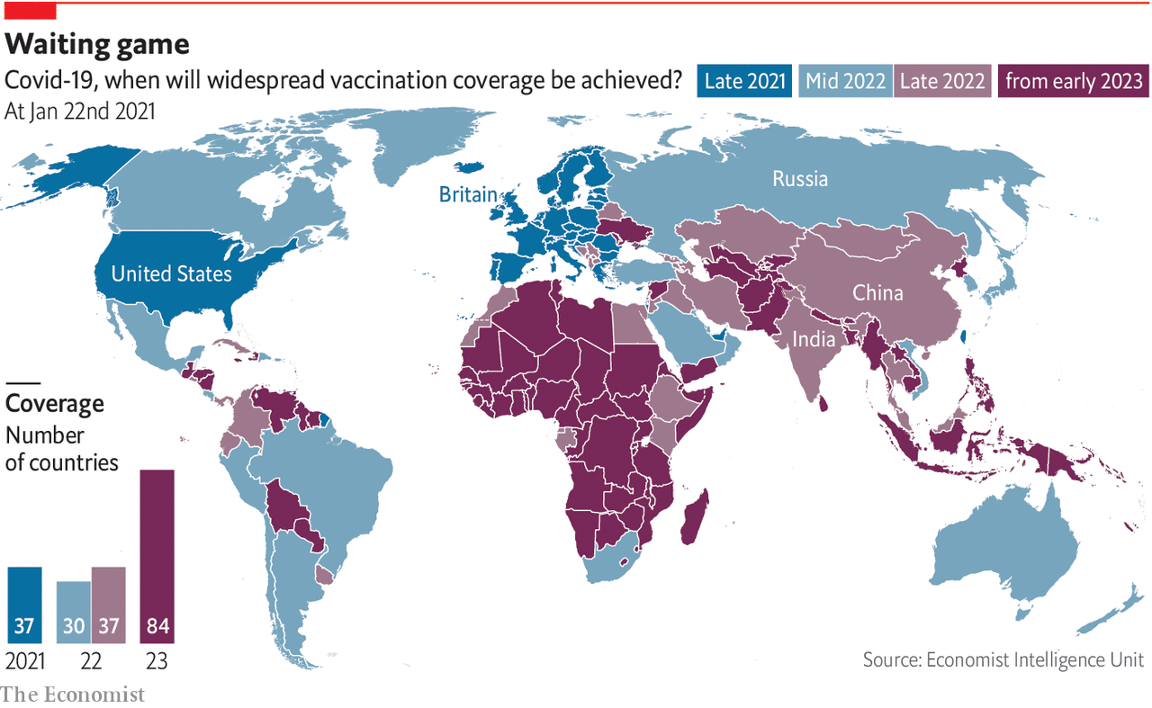

Slide 14
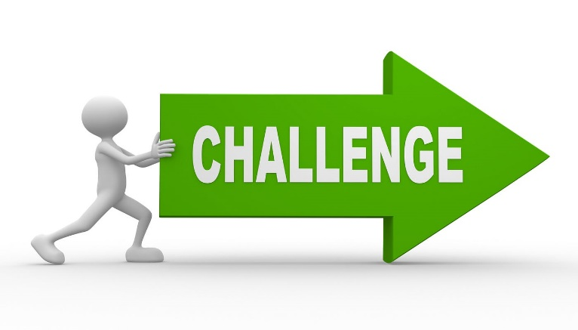
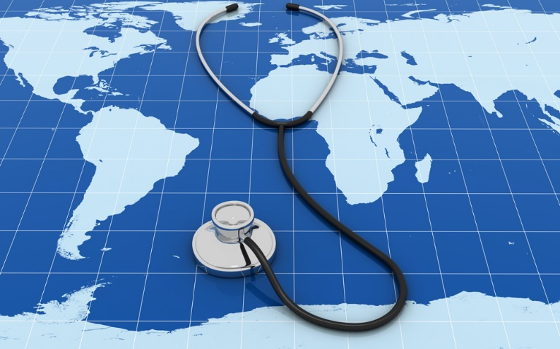
Challenges and Opportunities in GHD
Geopolitical tensions
Inequities in resource distribution
Limited data
Transparency

Slide 15
Opportunities
Building trust between nations
Enhancing global health security
Promoting sustainable development goals (SDGs)

Slide 16
Conclusion
Global Health Diplomacy is crucial for building stronger pandemic preparedness and response systems.
By fostering international collaboration, we can create a more secure and healthy future for all.
Together, we can build a healthier world!.

Slide 17
Call to Action
Let us continue to advocate for GHD to ensure a unified global response to future health crises.

Slide 18
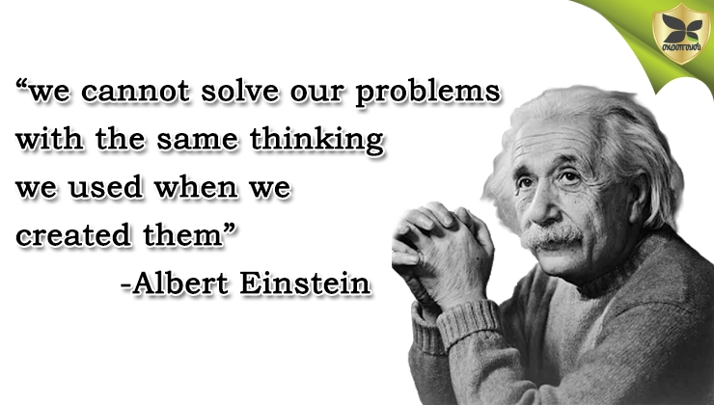
jkaracic@unizg.hr

